Slide 1
Hackathon Project Proposal
SOS AI PROJECT

Slide 2
Table of contents
01
02
03
04
05
06
the project
requirements
project goals
You can describe the topic of the section here
You can describe the topic of the section here
You can describe the topic of the section here
sneak peek
project stages
our team
You can describe the topic of the section here
You can describe the topic of the section here
You can describe the topic of the section here

Slide 3

Our COMPANY
SOS TECH is a platform that aims to bring together a diverse group of individuals and organizations in the technology industry to facilitate learning, skill development, and collaboration. By providing resources and guidance for learners, connecting mentors with those who are seeking guidance, and facilitating connection between developers and companies.

Slide 4
01
THE PROJECT
SOS ARTIFICIAL INTELLIGENCE - EMPOWERING THE BUSINESSES AND YOUTH

Slide 5
Problems we are working on
DISABLED PEOPLE
PERSON EATING FOOD
bUSINESS
A DISABLED PERSON CAN ALSO PERFORM TASKS USING VOICE OR TEXT
A PERSON WHO IS EATING FOOD BUT WANTS TO PERFORM HIS TASK
THIS PRODUCT CAN HELP BUSINESSES TO GROW THEIR ORDERS BY FEATURING THEM IN SOS AI

Slide 6
About the project
Mercury is the closest planet to the Sun and the smallest one in the Solar System—it’s only a bit larger than the Moon. The planet’s name has nothing to do with the liquid metal, since Mercury was named after the Roman messenger god

Slide 7
Project stages
STAGE 1
STAGE 2
STAGE 3
IDENTIFYING THE PROBLEM
FINDING AND WORKING ON SOLUTION
iNTRODUCING THE SOS AI
Neptune is the farthest planet from the Sun
sos

Slide 8
—Someone Famous
“This is a quote, words full of wisdom that someone important said and can make the reader get inspired.”

Slide 9
A picture is worth a thousand words

Slide 10
Project goals
Goal 1
Goal 2
TO PROMOTE THIS SOS AI WE ARE PARTNERING WITH 10+ COMMUNITIES TO TARGET THE STUDENTS
TO REACH MORE AUDIENCE WE WILL LAUNCH ON PLATFORMS LIKE PRODUCT HUNT
Goal 3
Goal 4
WE WIL REACH OUT TO THE BUSINESSES SO WE CAN FEATURE THEM AND PEOPLE CAN ORDER THINGS DIRECTLY
AT END WE WILL RETRIVE THE FEEDBACKS AND WORK ON IT

Slide 11
INFINITE
THERE ARE INFINITE POSSIBILITES TO GROW WITH THIS IDEA

Slide 12
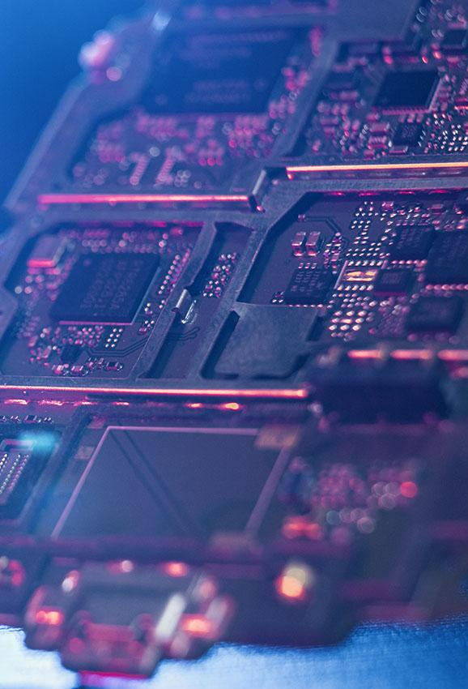
A picture always reinforces the concept
Images reveal large amounts of data, so remember: use an image instead of a long text. Your audience will appreciate it

Slide 13
TARGET AUDIENCE
TARGET
This Product Can Help DISABLED PEOPLE AS ACCESIBLITY
TARGET
THIS PRODUCT CAN HELP STUDENTS TO IMPROVE THEIR PRODUCTIVITY
TARGET
THIS PRODUCT CAN HELP BUSINESSES AND ENTERPRENEURS TO IMPROVE THEIR PRODUCTIVITY

Slide 14
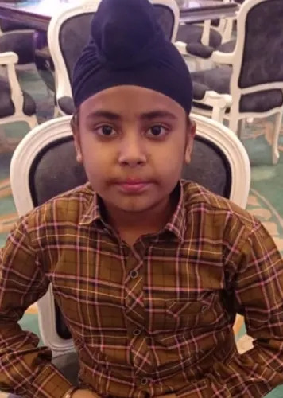
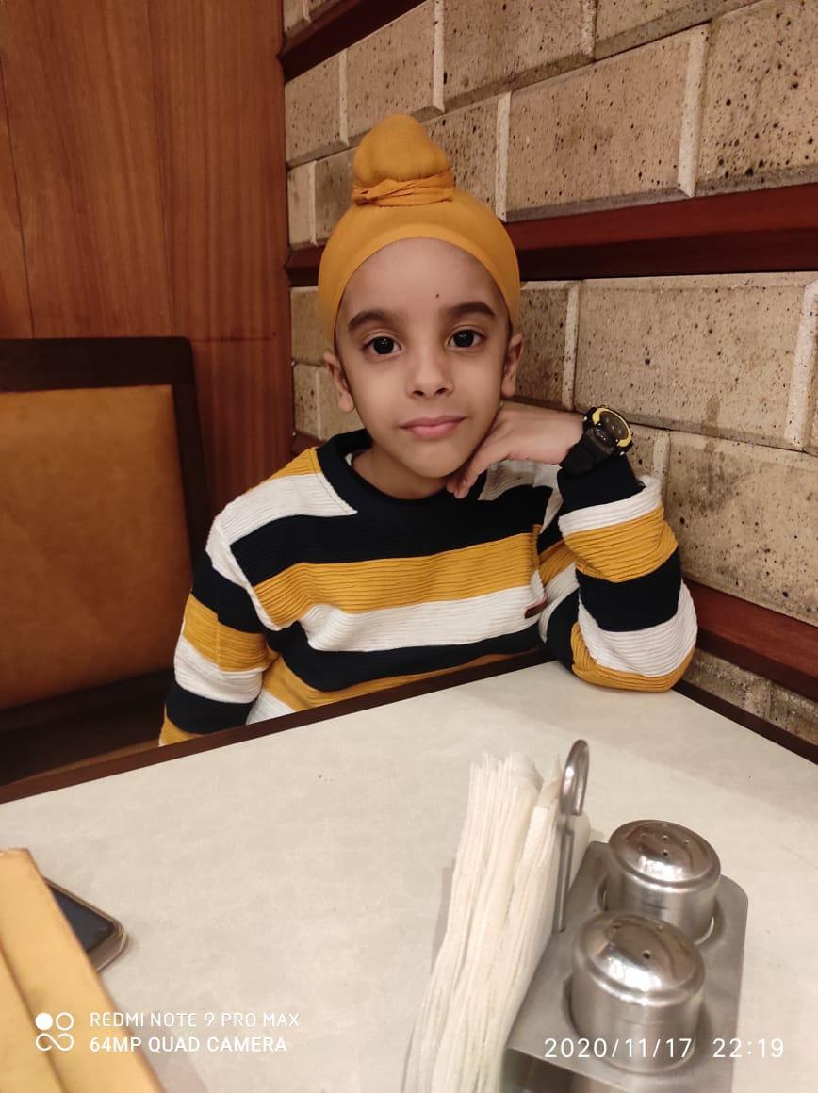
Our team
DIvjot Singh arora
Manraj singh Arora
Bio - Young Enterpreneur And Developer Helps In Development and DIstribution of Project
Bio - A Professional Gamer Helps in Identifying the problem

Slide 15

Thanks!
Hope You Liked Our Project And Idea
CodeINovact
Happy Coding! Happy Hacking!
SOS AI

